Slide 1
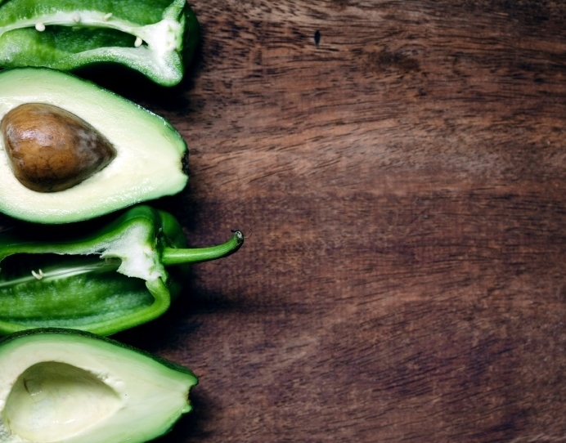
Royal Image café and eatery

Slide 2
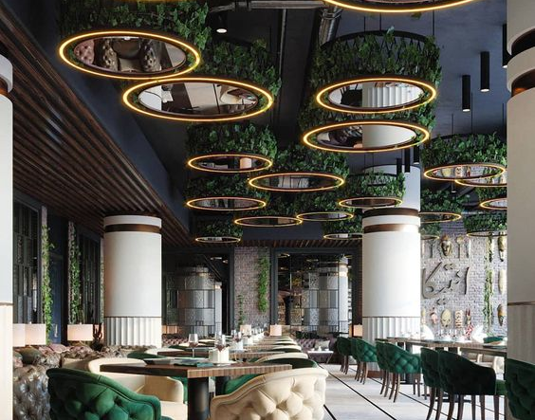
Welcome Feel free to ask any questions and note any allergy. Drink menu available upon request.
Please note, we are a small eatery that curates the finest one-of-a-kind meals on a rotating schedule. While the menu may look small, we deliver high quality with every dish.

Slide 3
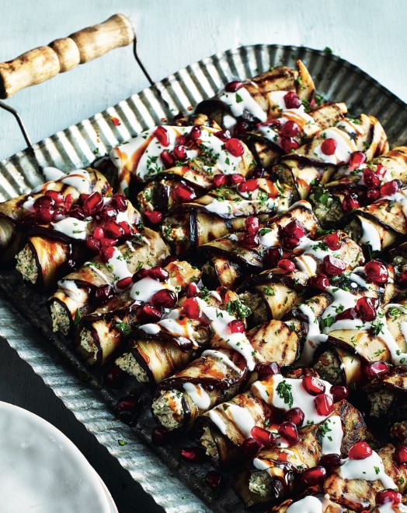
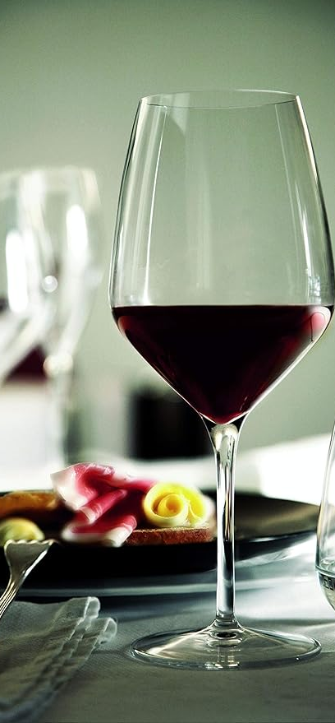
jpeg
Jovial Pieces of Eggplant and Goat Cheese (JPEG) – With this beautiful dish you can enjoy the brilliant 24-bit colors of the purple eggplant and red cranberries. Do not be fooled by the ease of this dish. JPEG can be enjoyed everyday and is a quick and convenient way to satiate your needs, but you will not lose any quality of the original ingredients. This smaller portion makes the JPEG ideal for any occasion.
(Pair with our house Chianti)

Slide 4
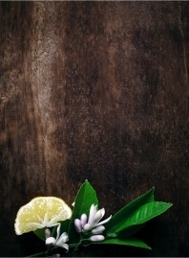


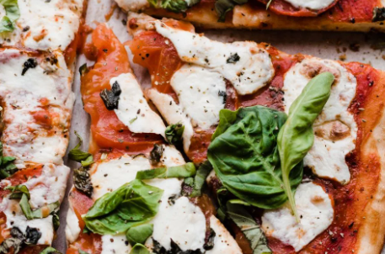
png
Pizza in a Naples Garden (PNG) – This is a classic dish with a little enhancement. Here you will see numerous vibrant colors, from presentation to bite, they tend to be a bit bolder than our JPEG. Being very versatile, this dish is great for every seat at the table. You will notice this is a larger item than the JPEG. A picture worthy dish, be sure to snap a digital image that can be used in photographs and graphics (make sure to tag us!)
(Pair with our house Pinot Grigio or locally brewed IPA)

Slide 5
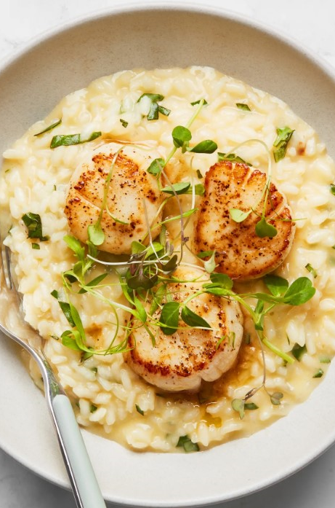


bmp
Basil Me Please (BMP) – Unlike the JPEG and PNG, this meal is easily editable, which is why it is so popular! Feel free to customize to your desire. With this dish you will get a large portion of our high-quality, raw (farm to table) vegetables and ingredients. Easily converted to suit the format of your tastebuds, pick your protein (chicken, steak, scallops, cauliflower steak) and we will perfectly prepare it atop a basil risotto that will showcase a multitude of vibrant and varying colors. This crowd-pleaser showcases its’ value while suiting your specific needs.
(Pair with our house White Burgundy Chardonnay)

Slide 6
tiff
Treats in Ferrero Fields (TIFF) – End your meal in luxury with this decadent dessert. Whether you are a cuisinier or a novice, this treat is perfect for you. The top tier detail put into this item ensures you will see the depth and detail of each color and ingredient used. This dish can be enjoyed at your table as well as at home. With unmatched excellence, you can save and re-save this dish without sacrificing quality. Combining multiple layers and transparency, you will find TIFF is (cont.)
(cont.) an above average dish, with detail without being too complicated and heavy. Whether large or small, one person or the whole family, we maintain quality from the entire cake to the smallest slice. Try it a la mode!
(Pair with our house Sauternes or espresso martini)

Slide 7
thank you for your patronage. Contact: royalimagece@yahoo.com (713)555-0555
Please note, we are a small eatery that curates the finest one-of-a-kind meals on a rotating schedule. While the menu may look small, we deliver high quality with every dish.

